Slide 1
STOCK MARKET FORECASTING
GUIDED BY:
RITESH MAURYA
PRESENTED BY:
Ayush Patidar
Aditya Rao
Nikhil Hosamani
Mohammad Farzan Faruqui
Lakshmi Supriya
Bhavitha Mitte
Aadarsh Asthana

Slide 2


INTRODUCTION
Stock market analysis is used to gain knowledge of the equity market to arrive at true value of a stock. It involves fundamental and technical research as its main tools.
Performing a research before making an investment is a must. It is only after a thorough research that you can make some assumptions into the value and future performance of an investment.
Even if you are following stock trading tips, it ideal to do some research, just to ensure that you are making an investment that’s expected to get you maximum returns.

Slide 3
OBJECTIVE
Our aim is to analyze previous stock data of single company, with help of certain parameters that affect stock value. We are going to implement these values in data mining algorithms.
This will also help us to determine the values that stock will have in near future.
We will determine the ‘Close’ price parameter with help of data mining algorithms and present it by graph.
Understand the concept of Model Deployment.
Deploy the model using Streamlit/flask/Django.

Slide 4
SOURCE & DATASET
Source of Dataset is ‘Yahoo finance’ (yfinance)
Dataset – NESTLE INDIA LIMITED (NESTLEIND.NS)
Duration – 1/1/11 to 30/6/22 (11½ years )

Slide 5
LIBRARIES
Pandas
Numpy
Yfianance
Seaborn
Matplotlib
Datetime
Sklearn
Shutup
Holidays
Plotly
Sktime
Prophet

Slide 6
Exploratory Data Analysis (EDA)
Importing the dataset (NESTLEIND.NS) directly from yahoo finance and setting Date as index.
Checking the shape of Dataset.
Checking for empty row or cell.
Checking various parameter using (df.describe).
Calculating daily return ((Nestle[‘Open’] - Nestle[‘Close'])/Nestle['Open’])
After the performing EDA plot graph for various parameter.

Slide 7
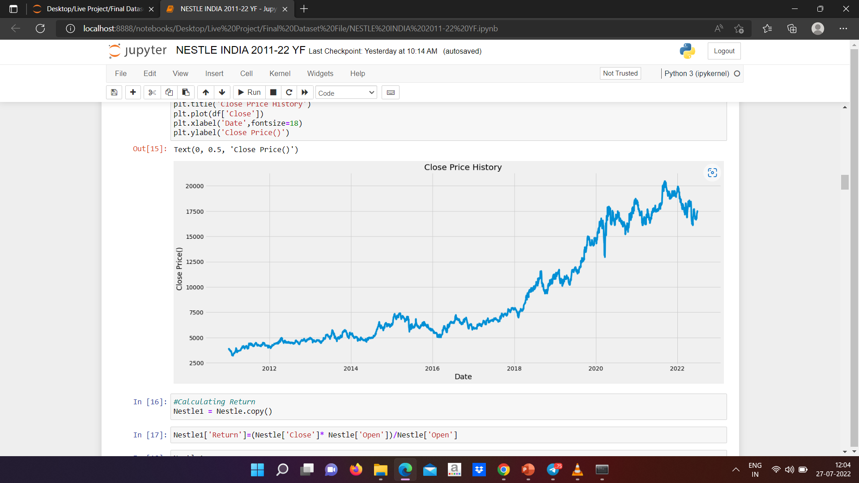
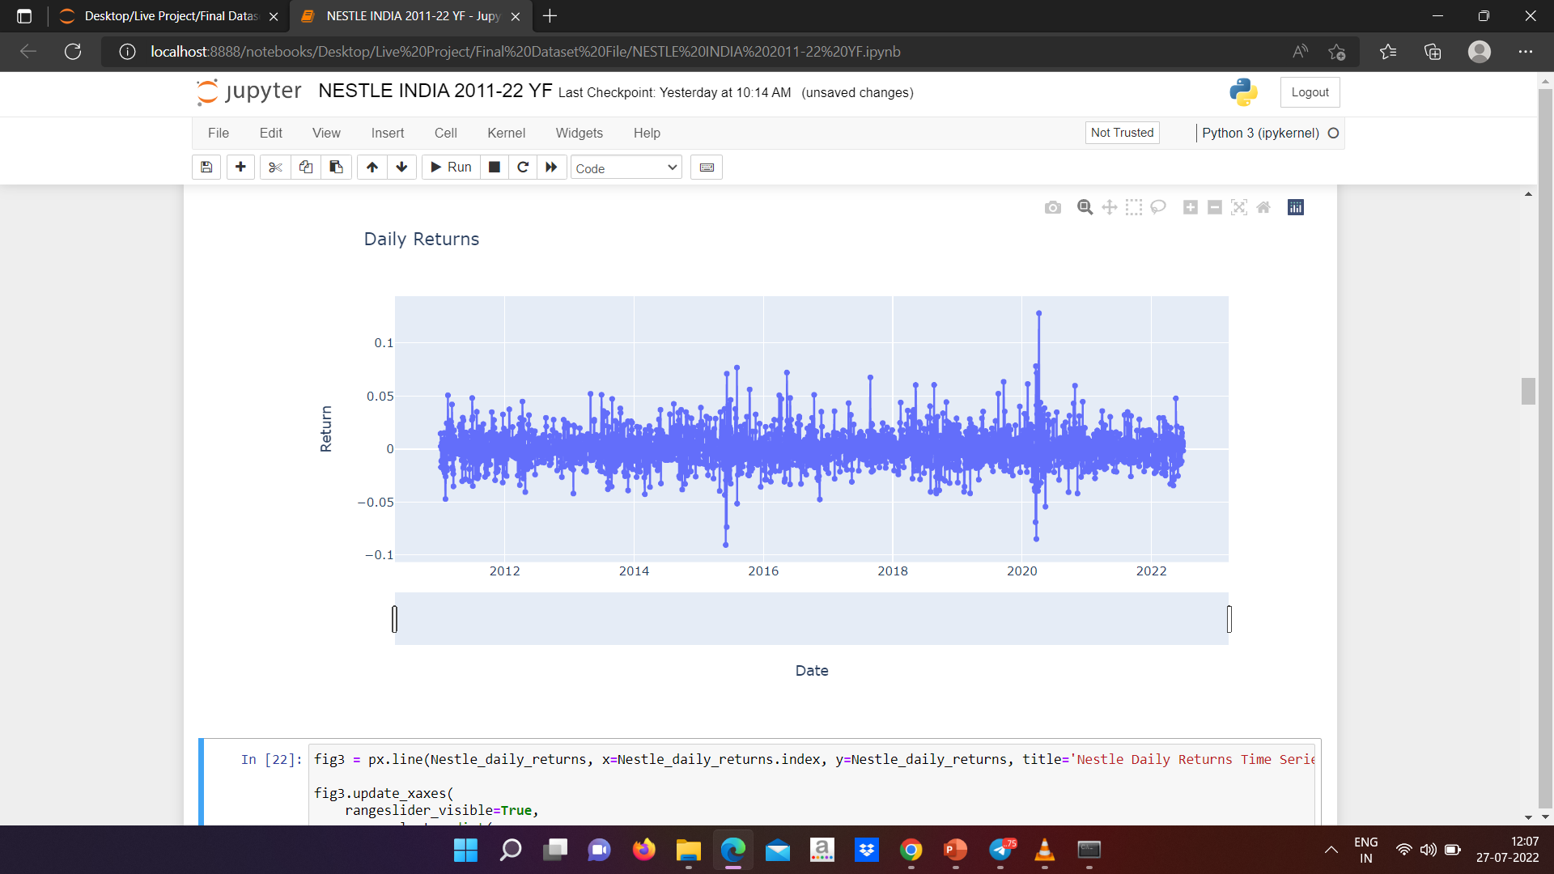
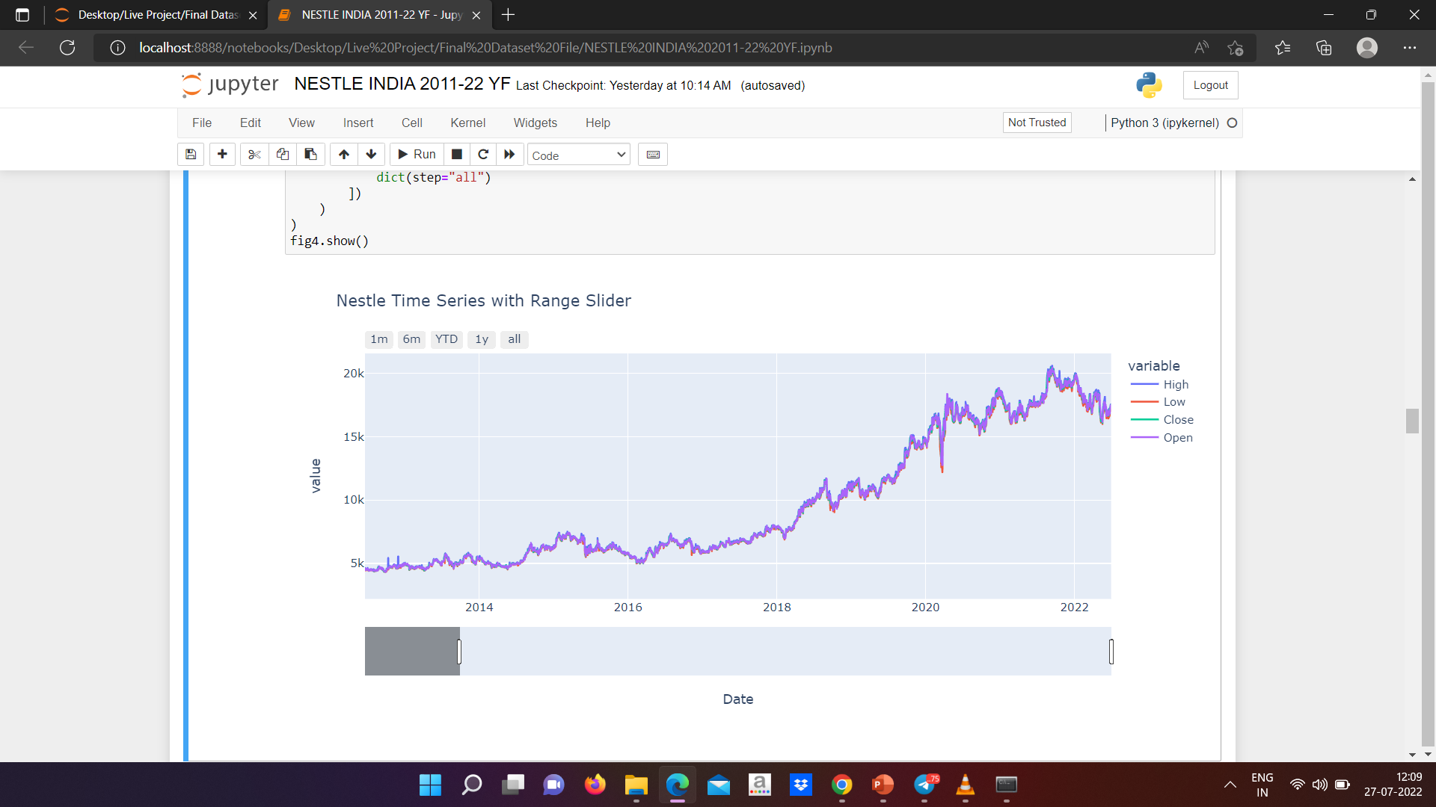
Visualization
Using plotly Library

Slide 8

Splitting Data into Training and Testing & Transform
Data from 1/1/2020 to 30/6/2022 is taken as testing data and rest of data is taken as training data.
Final shape of Dataset (2999,1)
Training Dataset – (2347,1)
Testing Dataset – (652,1)
Transform Dataset using MinMaxScaler.

Slide 9
Various Models
List of Models Created
Holt-Winters Methods(Exponential Smoothing Techniques)
TBATS Model (T for Trigonometric regressors. B for Box-Cox transformations. A for ARMA errors. T for trend.)
ARIMA Model
SARIMA Model
Prophet Model
LSTM Model

Slide 10
Model Selection
Exponential Smoothing
Exponential smoothing is generally used to make short term forecasts, but longer-term forecasts using this technique can be quite unreliable. More recent observations given larger weights by exponential smoothing methods, and the weights decrease exponentially as the observations become more distant. When the parameters describing the time series are changing slowly over time, then these methods are most effective.
Prophet Model
Prophet is a procedure for forecasting time series data based on an additive model where on non-linear trends are fit with yearly, weekly, and daily seasonality, plus holidays effects. It works best time series that have strong seasonal effects and several seasons of historical data.

Slide 11
Model Preparation
Exponential Smoothing
Prophet Model
Library
from sktime.forecasting.fbprophet import Prophet
import holidays
Calculated holidays i.e., 92 Indian Holidays
Calculated MSE & RMSE
MSE : 2242483.746
RMSE : 1497.492
Library
from statsmodels.tsa.holtwinters import ExponentialSmoothing
Four parameter were calculated but chosen with less MSE & RMSE values.
Multiplicative Trend and Multiplicative Seasonality
Calculated – MSE and RMSE
Errors :-
MSE : 3243185.387
RMSE : 1800.884

Slide 12
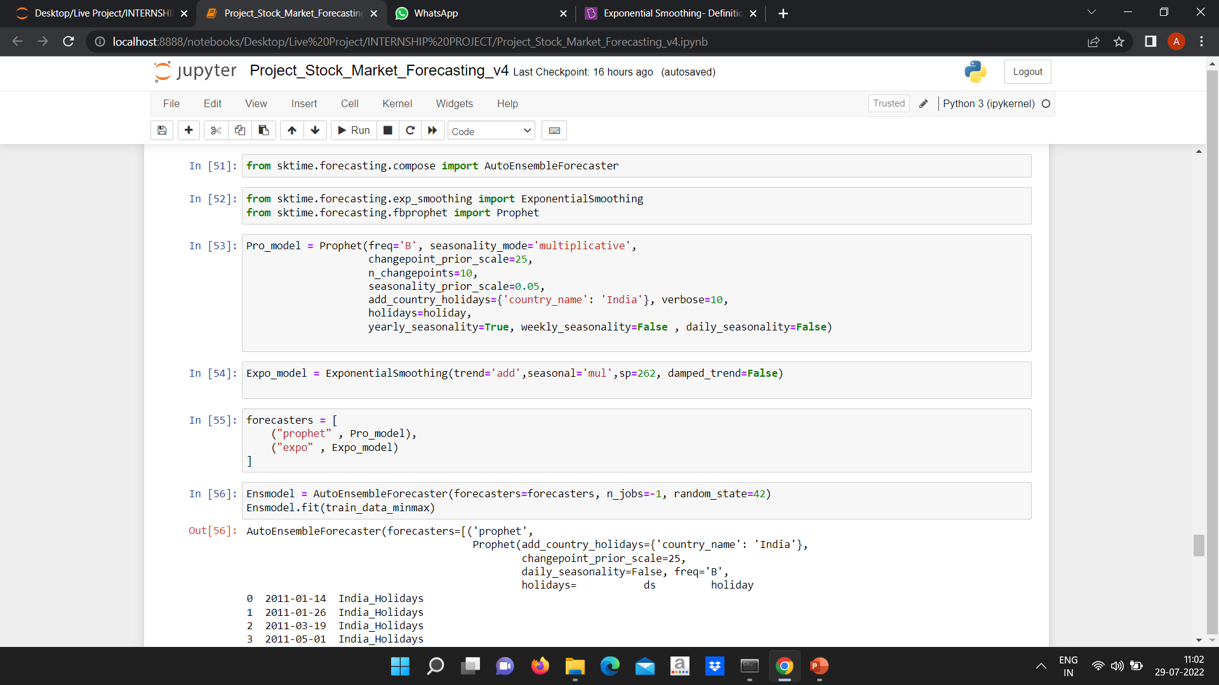
Auto Ensemble Forecaster
Exponential smoothing + Prophet model
Additive trend and Multiplicative Seasonality
Hyperparameter Tunning
Calculated MSE & RMSE
Errors :- MSE : 1524828.583
RMSE : 1234.619

Slide 13
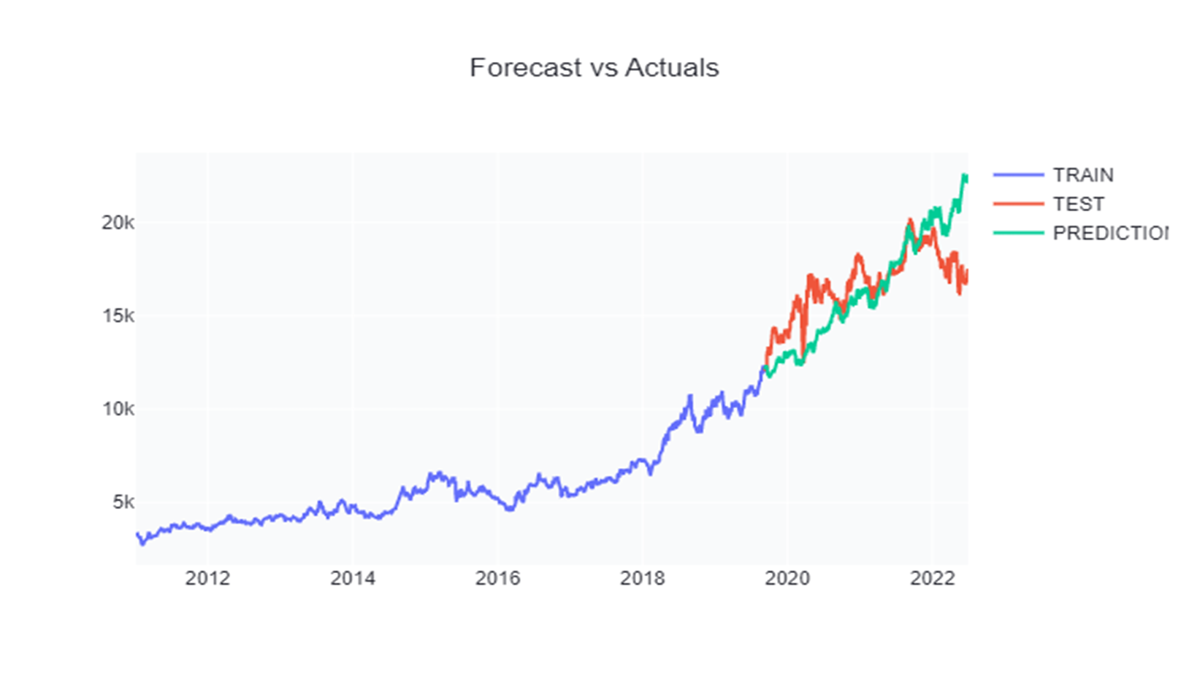
Forecasting

Slide 14
Deployment
Streamlit is an app framework to deploy machine learning apps built using Python.
Streamlit was used for deployment of model.
Stock prediction Application was also created. https://huggingface.co/spaces/Paatiii1712/stock_market_forcasting

Slide 15
Github Links
Ayush Patidar
https://github.com/AyuPaatii1712/Internship_Projects.git
Aditya Rao
https://github.com/AdityaRao09/Stock-Price-Prediction-With-Deployment.git
Lakshmi Supriya
https://github.com/LakshmiSupriya123/INTERN-SHIP_PROJECT
Farzan Nawaz Faruqui
https://github.com/Farzan04/Stock-Price-Prediction
Nikhil Hosamani
https://github.com/nikhillegend/Stock-Market-Forecast_Project/tree/main
Bhavitha Mitte
https://github.com/Bhavitha-Mitte/Stock-Market-Prediction

Slide 16

THANK YOU

